Slide 1

Optimizing JSM Promotions:
High-Volume Purchase Analysis and Discount
Protection Strategy
Risman Sudarmaji

Slide 2
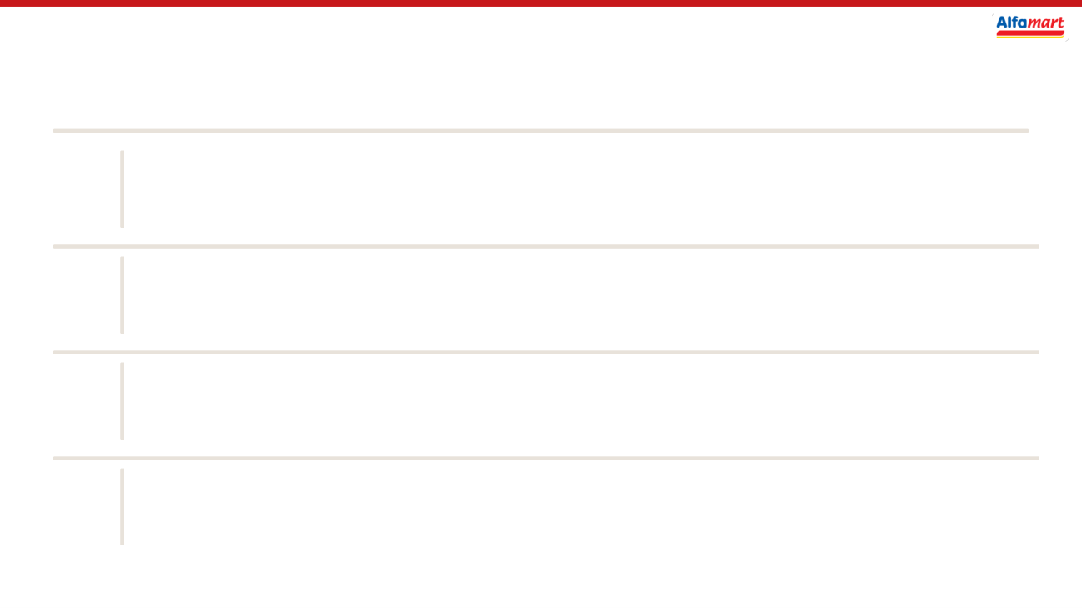
Contents
01
Background Context
02
Data Understanding
03
Analysis
04
Conclusion & Recommendation

Slide 3
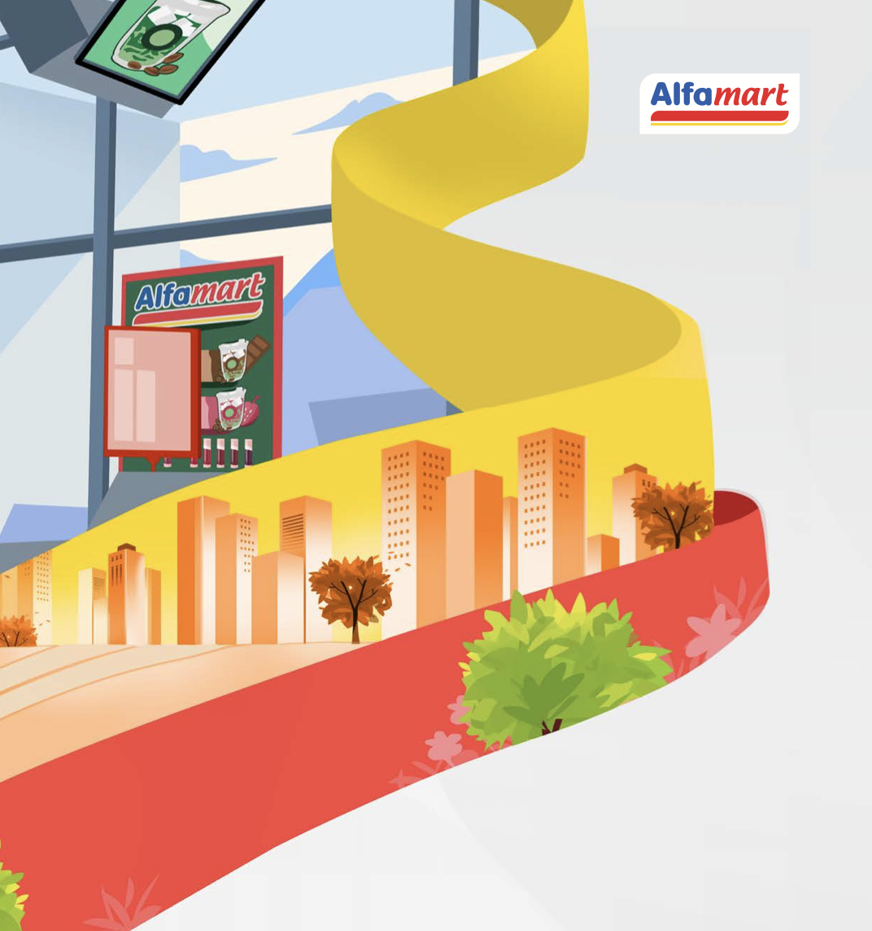
S E C T I O N
01
Background
Context

Slide 4

Retail Growth and the Role of Promotion
Indonesia’s retail sector continues to show positive momentum, with Food, Beverages, and Tobacco among the key contributors to retail sales growth. Seasonal demand periods such as Ramadan and Eid also produce substantial spikes in retail activity, supported by retailer discount strategies.
At the company level, Alfamart reported Rp118.23 trillion in net revenue in 2024, representing 10.55% growth from the previous year. At this scale, promotional programs can stimulate demand, but inefficient promotional allocation may also create significant financial exposure.
This creates a key business question:
How can JSM promotions remain attractive to customers while limiting excessive promotional discount exposure?
Sources: Bank Indonesia, Alfamart

Slide 5
Alfamart Scale, Growth, and Promotion Relevance
National Minimarket Store Network — FY2024
Alfamart Net Revenue Trend in 2018–2025
Rp126.74T
20,120
Source: Alfamart

Slide 6


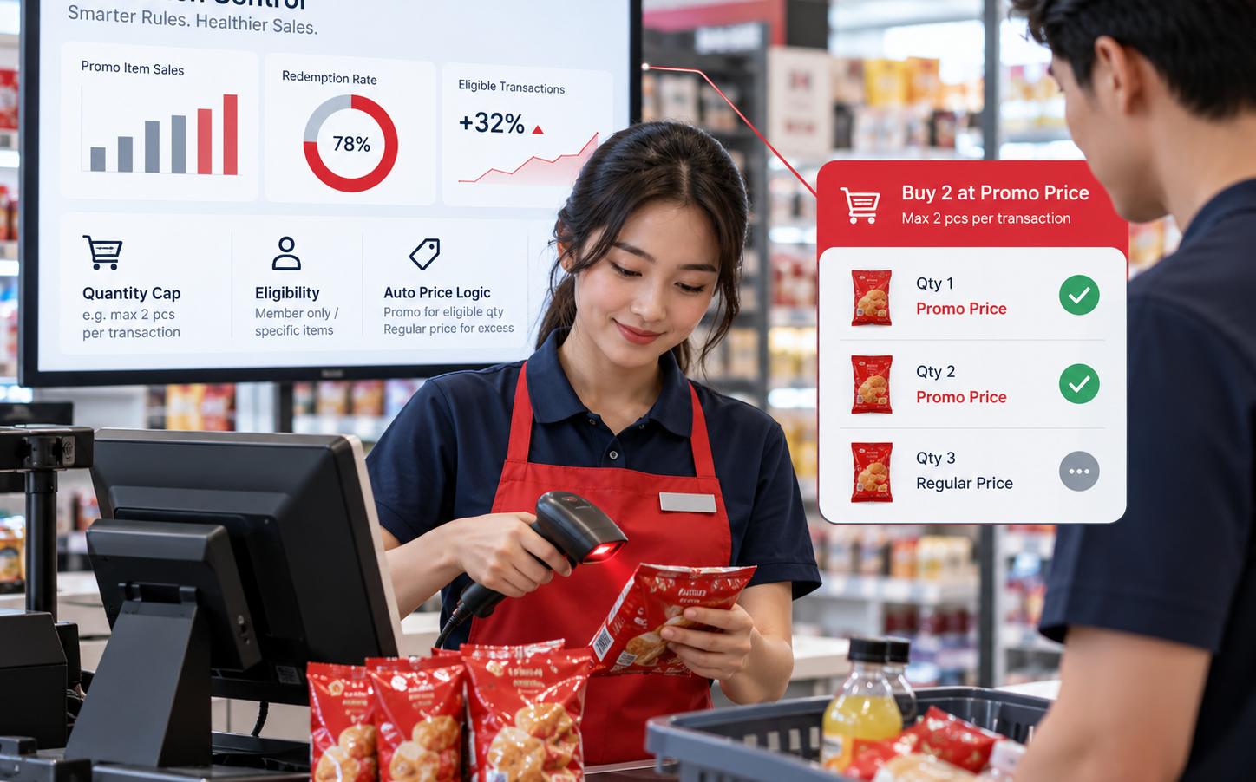
Problem Statement & Goal
1
High-Volume Purchase During JSM
2
Promotional Discount Exposure
3
Smarter Promotion Control
Is high volume purchasing materially more common when JSM is active?
How much promotional discount exposure is concentrated in high volume transactions?
What quantity based promo rule can protect efficiency without blocking purchases?

Slide 7

S E C T I O N
02
Data understanding
and cleaning

Slide 8
Data Foundation & Analytical Framework
1. Data Source
3. Analytical Framework
• 455,148 POS transactions
1
• 507 product SKUs
Purchase Behavior
JSM vs Non-JSM quantity pattern
• 1,003 stores
↓
• 48,214 members
• 10,759 complaint tickets
2
High-Volume Transactions
Regular vs high-volume vs suspected anomaly
↓
3
Discount Exposure
Quantify promotional discount exposure
2. Data Preparation & Validation
↓
• Standardize categorical values & data types
4
Policy Simulation
Universal caps vs SKU-specific P90/P95/P99
• Handle structural missing values
• Exclude invalid pre-opening/out-of-period rows
↓
• Validate store, SKU & member referential integrity
5
Targeting & Recommendation
Category impact + store-type prioritization
• Verify JSM discount logic against product master

Slide 9
Dataset Structure & Key Variables
ALFA_POS_TRANSACTIONS
ALFA_PRODUCTS
ALFA_STORES
Primary transaction table • 455,148 rows • 12 columns
Product master • 507 SKUs • 11 columns
Store master • 1,003 stores • 10 columns
receipt_id - unique receipt / transaction ID
sku_id - unique product identifier
store_id - unique store identifier
store_id - store where transaction occurred
product_name - product name
city - store city
sku_id - purchased product identifier
category - product category
province - store province
member_id - member ID; may be missing for non-members
brand - product brand
open_date - store opening date
trx_time - transaction date and time
unit_price - standard unit price
store_type - location / trade-area classification
qty - quantity purchased
is_jsm_promo - JSM promotion indicator
store_format - store format
discount_amount - discount applied to transaction
jsm_discount_pct - JSM discount percentage
region_code - regional identifier
transaction_status - completed or void status
ALFA_MEMBERS
ALFA_COMPLAINT_TICKETS
Customer membership master • 48,214 members • 10 columns
Customer complaint table • 10,759 tickets • 9 columns
member_id - unique member identifier
ticket_id - unique complaint ticket ID
registration_date - membership registration date
receipt_id - linked transaction receipt
home_city - member home city
complaint_category - complaint category
membership_tier - membership tier
ticket_date - complaint date
acquisition_channel - member acquisition source
resolution_status - resolution status
points_balance - current loyalty point balance
csat_score - customer satisfaction score
last_active_date - latest recorded activity date
disputed_amount - amount disputed by customer

Slide 10

S E C T I O N
03
JSM Promotion &
Purchase Behavior
Analysis

Slide 11
EXPLORATORY DATA ANALYSIS
Threshold Pattern
Analytical Clasification
Regular Purchase
qty ≤ 40
High Volume Purchase
qty 41–90
Suspected Qty Anomaly
qty > 90
25.06%
6.46%
High volume rate
on JSM Day
High volume rate
on Non-JSM Day
High volume purchasing is 3.88× more frequent on JSM days. 40 and 90 unit cutoff are analytical classification boundaries, not promotional caps
qty >90 is separated as a suspected quantity anomaly.

Slide 12
CUSTOMER PATTERN ANALYSIS
Repeat Frequency Among Member
Consistency Check
1 transaction
7984
Same SKU repeated
11 members
2 transactions
826
Same store repeated
15 members
3 transactions
64
4 transactions
3
Repeat members returning to same store
1.68%
Median interval between repeats
356 days
8,877
893
67
4
Intervals > 365 days
470
Unique members with
High volume purchase
Repeat members
(≥2 transactions)
Frequent members
(≥3 transactions)
Maximum high volume
transactions/member

Slide 13
FINANCIAL EXPOSURE ANALYSIS
High Volume Transactions Concentrate JSM Promotional Discount Exposure
Rp 7.97 B
Rp 5.91 B
74.14%
25.06%
Total JSM promotional
discount exposure
Discount exposure from
High volume purchases
Share of total JSM discount
associated with high volume
High volume transaction rate
on JSM days
Business Interpretation
High volume transactions are not the majority of JSM transactions, but they account for nearly three quarters of promotional discount exposure.
This makes quantity eligibility a meaningful promotion control lever.
74.14%
of JSM discount exposure
This is promotional discount exposure, not proven profit leakage. Actual profit impact would require product level margin/COGS data.

Slide 14
POLICY TRADE-OFF ANALYSIS
Universal quantity limits protect more discount, but affect more transactions
Universal Cap Scenarios
Potential Reduction
Limit 10
Rp 5.94 B
Limit 20
Rp 4.50 B
Limit 30
Rp 3.27 B
Limit 40
Rp 2.26 B
A single universal limit is simple, but it ignores different normal purchase quantities across SKUs. Lower limits protect more discount exposure but affect more transactions. Limit 40 is only the most conservative universal benchmark, not the final recommendation.

Slide 15
SENSITIVITY ANALYSIS
SKU Specific P95 Provides a More Balanced, Product Adaptive Policy
P90/P95/P99 Comparison
Non JSM Baseline
94
147–554
497
50
48.84%
Recomended
JSM SKU with
NonJSM baseline
Baseline transactions
per SKU
Median baseline
Transactions per SKU
40
32.55%
P95 Policy Impact
30
10,453
211,697
Rp 1.45 B
20
19.36%
18.20%
P95 affected
transactions
Excess units above
P95 eligibility
Potential discount
exposure reduction
10
4.30%
1.17%
P90 is materially more aggressive. P99 is too permissive. P95 is a defensible middle ground that adapts the cap to each SKU normal Non JSM purchase pattern. Excess units remain purchasable at regular price.
0
P90
P95
P99
Affected transactions
Discount exposure reduction

Slide 16
TARGETING ANALYSIS
The P95 Impact Is Highly Concentrated in NearMarket / Wholesale Stores
P95 Affected Transactions By Store Type (%)
Potential Discount Exposure Reduction By Category
Near Market / Wholesale
45.48%
Food & Staples
Rp 0.97B
Office
0.00%
Beverage
Rp 0.27B
Residential
0.00%
Personal Care
Rp 0.19B
Cigarettes
Rp 0.03B
P95 Impact in Near Market / Wholesale
10,453
211,697
Rp 1.45 B
Food & Staples contributes the largest absolute potential reduction Rp0.97B, while Personal Care has the highest affected-transaction rate 21.13%. These are different metrics, nominal value vs transaction rate.
Affected transactions
in Near Market / Wholesale
Total excess units
in this store type
Potential discount exposure
reduction concentrated here
In this dataset, the modeled P95 impact is concentrated in Near Market / Wholesale stores. This supports prioritizing that store type for a pilot. it does not prove that store type causes high volume purchasing.

Slide 17
ANALYSIS SYNTHESIS
Analysis to Action. Target the Promotion, Not the Customer
1. Detect
2. Quantify
3. Calibrate
4 Target
5 Monitor
JSM high volume rate
25.06% vs 6.46%
(3.88× higher)
Rp7.97B total JSM discount
Rp5.91B / 74.14% linked
to high volume purchases
Use SKU specific Non JSM
Baseline. P95 balances
customer impact and exposure
Prioritize Near Market /
Wholesale stores where
45.48% are affected
Allow excess units at
regular price, monitor sales,
complaints and recalibrate
→
→
→
→
19.36%
Rp 1.45 B
18.20%
Transactions affected
under P95
Potential discount exposure
reduction
Share of total JSM discount
exposure potentially reduced

Slide 18

S E C T I O N
04
Conclusion &
Recommendation

Slide 19
CONCLUSION
JSM shifts purchase behavior toward higher quantities, but the strongest action is to control promo eligibility, not customer purchasing.
1
JSM materially changes purchase behavior
2
Discount exposure is highly concentrated
High volume transactions are 25.06% on JSM Days versus 6.46% on Non JSM Days. Its about 3.88× higher.
High volume transactions represent only 25.06% of JSM transactions but account for 74.14% of JSM promotional discount exposure.
3
High volume ≠ proven reseller behavior
4
One size fits-all limits are too crude
Most repeat behavior is sporadic The data does not justify labeling high volume customers as resellers or fraud.
Normal purchase quantities differ by SKU, making an SKU specific baseline more defensible than a single universal cap.
BOTTOM LINE
The evidence supports a targeted promo eligibility rule that preserves the customer’s ability to buy additional units at regular price.
Target the promotion, not the customer

Slide 20
RECOMMENDATION
SKU-Specific P95 Promo Eligibility Cap
Use each SKU’s Non JSM purchase pattern as the baseline, then limit JSM promo eligibility, not total purchase quantity.
RECOMMENDED
P95 per SKU → promo applies up to the cap. Excess units remain purchasable at regular price.
Policy Logic
Expected Policy Impact
qty ≤ P95 cap
qty > P95 cap
19.36%
Rp1.45B
18.20%
→
JSM promo price applies
Excess units → regular price
Transactions affected
Potential discount exposure reduction
Share of total JSM discount exposure
Implementation Priority
1
Pilot
2
Monitor
3
Recalibrate
4
Scale
Start with Near Market / Wholesale stores, where modeled P95 impact is concentrated.
Track sales, basket size, discount exposure, complaints, and split transactions.
Refresh P95 caps periodically using the latest Non JSM baseline.
Expand only if pilot KPI remain stable and customer impact is acceptable.

Slide 21


